Slide 1
English for
International
Communication

Slide 2
實戰篇 Unit 4
「簡短獨白」
各類題材攻略

Slide 3
實戰篇 Unit 4
在「奠基篇」中學習各種常考問題後，現在我們藉由下表來了解常考的獨白類型與題材有哪些。接著，我們再依照各類型的獨白提供最常見相關題材內容的範例和練習。
獨白題材
類型 1 | Announcement 公告或宣布 | • 機長報告 • 商場或機場廣播 • 辦公室公告
類型 2 | Introduction 介紹或引言 | • 介紹來賓 • 公司或產品／服務簡介 • 導覽介紹 • 會議或活動開場白

Slide 4
實戰篇 Unit 4
類型 3 | Instruction 指示或說明 | • 員工訓練 • 工作或活動流程說明
類型 4 | Media Broadcast 廣播或電視媒體 | • 氣象報告 • 路況報導 • 廣告推銷 • 電台節目介紹 • 新聞報導
類型 5 | Voice Message 語音訊息 | • 電話留言 • 電話語音指示 • 答錄機留言
類型 6 | Speech/Lecture 演講 | • 各類主題演講 • 得獎感言 • 退休感言

Slide 5
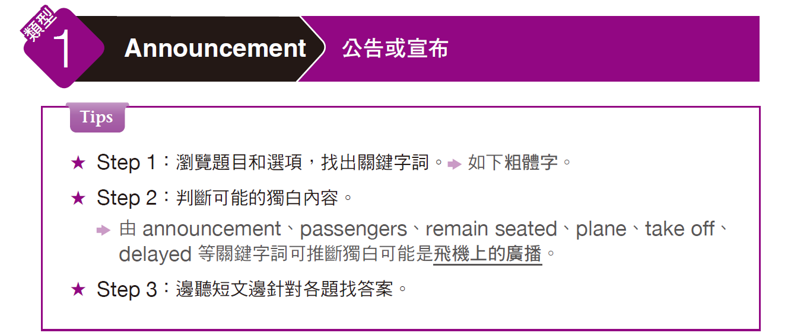
實戰篇 Unit 4

Slide 6

實戰篇 Unit 4
Example
C
B
C
1. What is the purpose of this announcement?
(A) To ask passengers to remain seated
(B) To inform passengers the plane will take off forty minutes early
(C) To inform passengers the flight will be delayed
(D) To explain fog in Seattle will make the flight late
2. What will the representatives at the gate in Seattle do?
(A) Advise passengers on their trip to Seattle
(B) Help passengers who are changing planes
(C) Help passengers buy return tickets
(D) Tell passengers how to make business connections in Seattle
3. What will the passengers be able to do shortly?
(A) Have beverages and snacks
(B) See the side of another aircraft
(C) See a mountain that is very tall
(D) See a lake that is fourteen thousand feet across

Slide 7
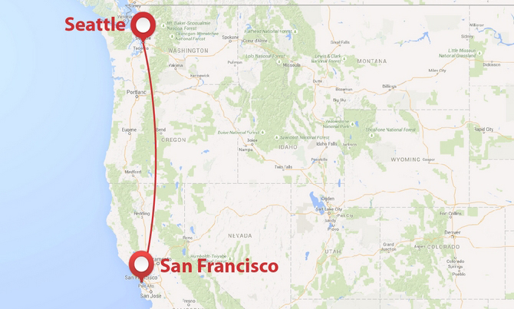

Slide 8
實戰篇 Unit 4
錄音內容 & 解析
得知為
機長廣播
Questions 1-3 refer to the following announcement.
Good morning, this is your captain speaking. Welcome aboard TransWorld Airlines Flight 103 from San Francisco to Seattle.
We apologize for our late departure, but as is sometimes the case at San Francisco, the fog was too thick to take off in. Our current estimated time of arrival is eleven thirty-five, about forty minutes past our scheduled arrival time.
Q1
廣播主目的是告知班機將延遲抵達目的地，故答案選 (C) 。選項 (D) 要注意 fog「濃霧」是在舊金山（San Francisco），而非西雅圖（Seattle）。

Slide 9
實戰篇 Unit 4
Passengers making connecting flights in Seattle should see our representatives at the gate for assistance. In the meantime, please enjoy your flight.
In a few minutes, you will be able to see Mount Shasta out the right side of the aircraft. As you will see, at fourteen thousand feet, the peak has plenty of snow even at this time of year.
Q2
解題關鍵字詞為選項 (B) 中的 changing planes = 獨白中making connecting flights，故答案選 (B)。
Q3
題目問乘客不久後（shortly）可以做什麼？獨白中 In a few minutes . . . 後面的敘述為關鍵，故答案選(C) 。

Slide 10
實戰篇 Unit 4
中文翻譯
早安，這是機長廣播。歡迎搭乘環球航空103 航班，由舊金山飛往西雅圖。我們要為遲飛向您說聲抱歉，但是舊金山有時候就是這樣，霧實在太濃，以致於無法起飛。我們目前估計的抵達時間是十一點三十五分，比預定抵達時間大約晚四十分鐘。要在西雅圖轉機的乘客，請在登機門向本公司的代表尋求協助。於此同時，請享受這趟飛行。幾分鐘後，各位將會在飛機的右側看到夏斯塔山。各位將會看到，這座高一萬四千英尺的山，它的山峰即便在每年這個時候還是有大量白雪。

Slide 11
實戰篇 Unit 4
Exercise
Listen to the audio track. Answer the three questions about what the speaker says in the talk.
A
B
C
1. How should people staying in Chicago dress?
(A) They should dress for a cold day.
(B) They should dress for a sunny day.
(C) They should wear light clothes.
(D) They should enjoy the beautiful day.
2. Which is true about the flight?
(A) It is behind schedule.
(B) It is arriving early.
(C) It is crowded.
(D) All passengers are staying in Chicago.
3. What will the passengers be able to see from the plane in a few minutes?
(A) The mountains near the city
(B) The lake next to the city
(C) The city’s downtown area
(D) Chicago O’Hare Airport

Slide 12
實戰篇 Unit 4
錄音內容
Questions 1-3 refer to the following announcement.
This is your captain speaking. We’ll be landing at Chicago O’Hare Airport in about 30 minutes. The current time in Chicago is 2:30 p.m. It is a beautiful, sunny day, but the temperature is only 42 degrees and, as is normal in Chicago, it is windy, so put on your coat if Chicago is your destination. We are landing about 20 minutes ahead of schedule—it is nice to be early for a change—so if you are changing planes here, you should have plenty of time to get to your connecting flight. Off to the right of the aircraft in a few minutes, you’ll be able to see downtown Chicago—a beautiful view of the city’s tall buildings on a sunny day. Lastly, let me thank you for flying with us today. We hope you had a pleasant flight.
• ahead of schedule 提前

Slide 13
實戰篇 Unit 4
中文翻譯
這是機長廣播。我們即將在大約三十分鐘後，在芝加哥的歐海爾機場降落。芝加哥現在的時間是下午兩點半。天氣狀況良好而晴朗，但溫度只有華氏四十二度，算是芝加哥的正常溫度。那裡風大，所以如果您的目的地是芝加哥的話，就把外套穿上。我們落地的時間比預定時間早了約二十分鐘，能改變一下早點抵達也不錯，如果您要在芝加哥轉機的話，您應該有充裕的時間銜接下一班飛機。幾分鐘後，您將可以在飛機的右側看到芝加哥市中心，在晴朗的日子裡，芝加哥市高聳的建築物景致十分美麗。最後，我要謝謝各位搭乘本班機，希望您有趟愉快的航程。

Slide 14
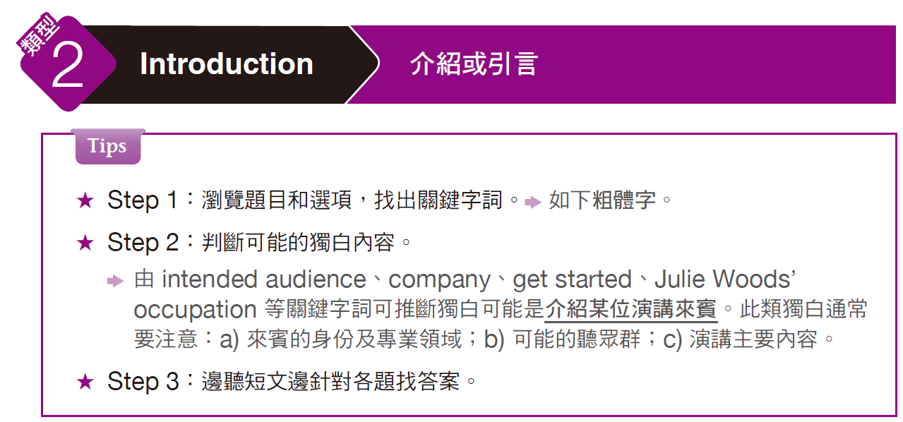
實戰篇 Unit 4

Slide 15
實戰篇 Unit 4
Example
1. Who is the intended audience for this talk?
(A) Art collectors
(B) Business executives
(C) Moviegoers
(D) Restaurant owners
2. According to the speaker, what must a company do to get started?
(A) Invest in other companies
(B) Create an impressive product or service
(C) Find people willing to give it money
(D) Find a prominent location to open an office
3. What best describes Julie Woods’ current occupation?
(A) A stockbroker
(B) A photographer
(C) A consultant
(D) An investor
B
C
D

Slide 16
實戰篇 Unit 4
錄音內容 & 解析
得知為
介紹來賓
Questions 1-3 refer to the following introduction.
I hope everybody enjoyed their lunches. Today, we have a fascinating speaker: Julie Woods.
A serial entrepreneur, Julie has started no fewer than six companies in her career. Now the first big step for any new company is to find investors to finance the company. Few companies can get started without outside investment. And that’s the topic Julie is going to speak on today: what companies must do if they want to attract investors.
Q1 從開創公司的演講主題及公司如何吸引投資者等獨白內容可推斷聽講者可能為(B)「企業高階主管」。此類題型可聽完整體內容最後再回答。
Q2 獨白中說公司創立要有outside investment「外來的投資」，故選項 (C) 意思相符。(B)、(D) 中的 product、service、location 等關鍵字獨白中並未提及。而 (A) 雖有相關字 invest，但說要「投資別家公司」，與獨白內容不符。

Slide 17
實戰篇 Unit 4
And Julie is just the person to speak on the subject. Not only has she founded six companies, but she has taken the profits she made from those companies and she now spends her time investing in other people’s companies herself. Now, let’s turn the podium over to Julie Woods!
Q3
問 Julie Woods 目前的職業，從關鍵句 she now spends her time investing in . . . 得知她應為選項 (D) 「投資家」。

Slide 18
實戰篇 Unit 4
中文翻譯
我希望大家喜歡你們的午餐。今天，我們請到一位迷人的講者，茱莉‧伍茲。茱莉‧伍茲是一位連續創業家，她在她的職業生涯中一共成立了六家以上的公司。任何一家新公司要踏出的第一大步就是要找到投資人來資助公司。很少有公司能不靠外部的投資而創立，而這就是茱莉今天要演說的內容：公司若要吸引投資人該怎麼做？茱莉是演講這個主題的不二人選。她不只創立了六家公司，而且還從這些公司中獲利，現在她將時間花在投資其他人的公司上。現在我們就將講台交給茱莉‧伍茲！

Slide 19
實戰篇 Unit 4
Exercise
Listen to the audio track. Answer the three questions about what the speaker says in the talk.
B
A
C
1. What is the main topic of the debate?
(A) Whether to build a train line to the city
(B) Whether or not the train line should go downtown
(C) How much money to spend on building a train line
(D) How many stations should be built in the city
2. What might be good about a downtown station?
(A) It could help the businesses downtown.
(B) It would take cars off the streets downtown.
(C) It could make the downtown area more beautiful.
(D) It would be less expensive than the alternatives.
3. What will happen next?
(A) The mayor will welcome the speakers.
(B) The downtown area will become ugly.
(C) The mayor will speak to the audience.
(D) Members of the Downtown Business Association will vote.

Slide 20
實戰篇 Unit 4
錄音內容
Questions 1-3 refer to the following introduction.
Good evening. I want to thank everyone for coming to tonight’s debate. As you all know, the state is going to build a new train line through our city. The question is whether we want the train line to come downtown, or whether we want it to stop outside the city. Our city’s Downtown Business Association believes that a downtown train station will help our city’s businesses—that they would make a lot more money. But our city’s mayor believes a downtown train station would ruin the beauty of our downtown area—that it would make our downtown ugly. And tonight both the mayor and the head of the Downtown Business Association will speak
and explain their opinions. Let’s begin by welcoming our mayor, Mayor John Thomas . . .
• debate (n.) 辯論會 • ruin (v.) 使毀滅；毀壞

Slide 21
實戰篇 Unit 4
中文翻譯
晚安，我要謝謝各位參與今晚的辯論會。各位都知道，政府要蓋一條新的鐵路線穿過本市。問題是，我們是否要讓鐵路線來到市中心，還是我們要讓路線止於城市外圍。本市的「市中心商務協會」相信，在市中心設立火車站將有助於本市的商業活動，他們將可以因此賺更多錢。但本市市長認為，在市中心興建火車站將會破壞市中心區域的美觀，如此一來，本市市中心會變醜。今晚，市長和「市中心商務協會」的會長將會各自表達與說明他們的意見。首先歡迎我們的市長，約翰‧湯瑪士市長……

Slide 22
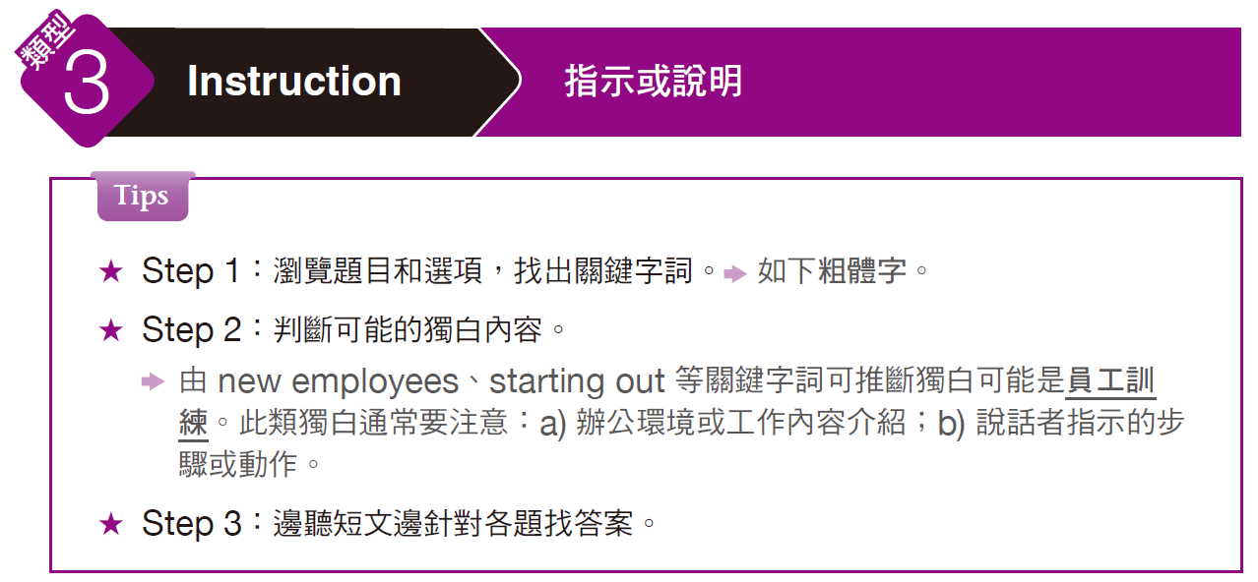
實戰篇 Unit 4

Slide 23
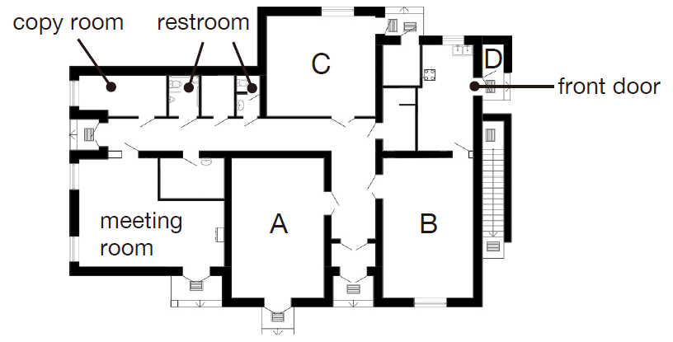
實戰篇 Unit 4
Example
1. How many new employees are starting out at the company?
(A) Three
(B) Six
(C) Ten
(D) Five
2. Look at the graphic. In which room can employees go to make coffee?
(A) A
(B) B
(C) C
(D) D
3. What will the speaker do next?
(A) Make copies for the new representatives
(B) Make some fresh coffee for everyone
(C) Buy office supplies for the company
(D) Answer questions that the new staff have
B
D
D

Slide 24
實戰篇 Unit 4
錄音內容 & 解析
Questions 1-3 refer to the following talk and floor layout.
Welcome to our company. My name is Sara Bennett, and I am our company’s business manager.
It’s wonderful to have six new sales representatives starting at once. That makes it easier for me to help you get started.
得知說話者身份為公司主管。
Q1
題目問有幾位新員工，屬細節題，一聽到就要馬上作答，由獨白中可知答案選 (B) 「六位」。

Slide 25
實戰篇 Unit 4
Now, each of you will get your own desk and computer over here. And down this hall is the copy room, where you can get copies and stationery supplies. Out by the front door is the kitchen, where you can make coffee and use the refrigerator. It’s the door just next to the front door. Now I am going to give each of you an orientation sheet. These have your new e-mail addresses and passwords, and a list of important company policies.
In a minute, I’ll give you a chance to ask any questions you might have.
Q2 問哪裡可以煮咖啡，亦屬細節題，要注意聽關鍵字 make coffee。與獨白中 Out by the front door . . .意思最接近的答案為(C)「在前門附近」。
Q3 屬題目有關鍵字 will . . . next 的特殊題型，答案通常會在獨白的後段出現。最後一句 In a minute . . .之後的敘述即為答案，故選 (D)

Slide 26
實戰篇 Unit 4
中文翻譯
歡迎來到我們公司，我的名字是莎拉‧班尼特，我是我們公司的業務經理。能夠一次同時擁有六名新的業務代表，真是太棒了。這讓我能更容易協助各位上手。這裡有各位自己的桌子和電腦，這條走道往前走是影印室，你們可以在那裡影印並拿取文具。從前門出去是廚房，你們可以在那兒泡咖啡和使用冰箱，門就位在前門的旁邊。現在我要給每個人一張報到表，上面有你們的新電子信箱和密碼，還有一份關於公司重要政策的清單。一分鐘後，我會給各位機會問問題。

Slide 27
實戰篇 Unit 4
Exercise
Listen to the audio track. Answer the three questions about what the speaker says in the talk.
B
D
B
1. What kind of company does the speaker work for?
(A) A delivery company
(B) A real estate agency
(C) A law firm
(D) A financial services company
2. What is one thing that the brochure tells people?
(A) How much money the company will charge
(B) How people can make their homes more marketable
(C) How to design brochures for direct mail
(D) How the company can help sell homes
3. Which of the following is NOT in the envelope?
(A) A price comparison list
(B) An address list
(C) A brochure
(D) A letter

Slide 28
實戰篇 Unit 4
錄音內容
Questions 1-3 refer to the following talk.
Let’s get started. This week we’re going to carry out a major direct mailing drive to try and get more customers for our real estate services. The mailing will include an introduction letter, a brochure showing how we can help buy and sell homes, and a price comparison list of home prices in the area. Now, begin by taking a letter from this stack and then an envelope from that stack. Make sure the address on the letter matches the address printed on the envelope. Next, put the letter into the envelope, along with a brochure and a price comparison list. When you have sealed the envelope, put it into this box.
• direct mail 向廣大群眾直接投寄的廣告郵件（簡稱 DM）
• comparison (n.) 比較 • stack (n.) 一堆；一疊

Slide 29
實戰篇 Unit 4
中文翻譯
我們開始吧。本週我們要進行一項重要的直接郵寄活動，設法為我們的不動產服務尋找更多的客戶。郵寄的內容將包括一封簡介信、一份展示我們能如何協助購買及銷售房屋的手冊、以及本區房屋價格的對照表。現在先從這一疊中拿出一封信，然後從那一疊中拿出一個信封。務必確認信上的地址要和列印在信封上的地址相吻合。下一步，將信放進信封裡，連同一份手冊和一張價格對照表。封好信封後，就放進這個盒子裡。

Slide 30
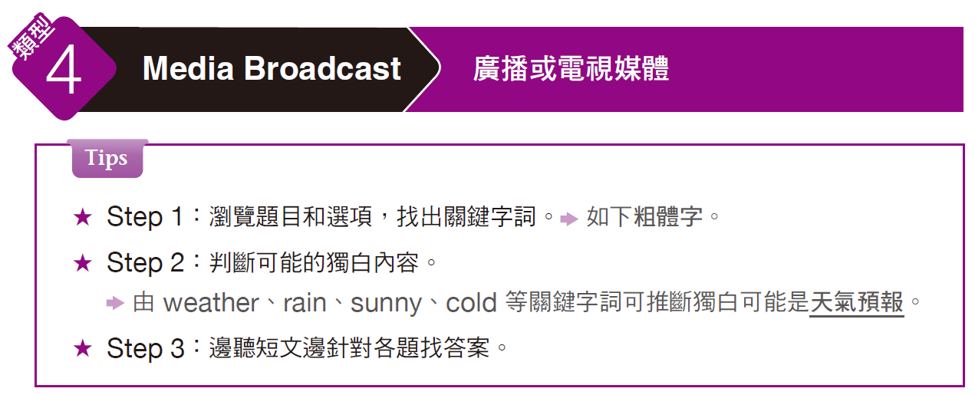
實戰篇 Unit 4

Slide 31
實戰篇 Unit 4
Example
A
C
D
1. What does the speaker imply about today’s weather?
(A) It might rain.
(B) It is sunny.
(C) It is raining now.
(D) It is cold.
2. Which day will be the warmest?
(A) Today
(B) Saturday
(C) Sunday
(D) Monday
3. How will the weather be next week?
(A) Sunny
(B) Warm
(C) Snowy
(D) Rainy

Slide 32
實戰篇 Unit 4
錄音內容 & 解析
Questions 1-3 refer to the following radio broadcast.
Now, let’s look at the weather.
So far, we haven’t had any rain today, though there are a lot of dark clouds out there, so get your umbrellas out.
聽到 weather 得知為天氣預報。
Q1
題目問「今天天氣可能會如何？」，獨白中沒有直接說會下雨，但由 . . . a lot of dark clouds 及 get your umbrellas out 等關鍵字詞可推斷答案選 (A)「可能會下雨。」

Slide 33
實戰篇 Unit 4
But the good news is those nasty-looking clouds are going to go away overnight and we’re going to have sunny skies and warmer weather this weekend. We’re looking for highs in the 70s on Saturday and temperatures on Sunday may reach 90 degrees!
But then on Monday, another storm will arrive, and it looks as though we’re going to have another cold, rainy week.
Q2
此為細節題，問「哪一天會最溫暖？」，關鍵句為 . . . Sunday may reach 90 degrees，此為整段獨白中所提到的最高溫度，故選 (C)。
Q3
亦屬細節題，問「下週天氣如何？」，關鍵句在獨白的最後一句. . . have another cold, rainy week，故答案選 (D)。

Slide 34
實戰篇 Unit 4
中文翻譯
我們來看天氣。今天到目前為止都還沒有下雨，但外頭烏雲密布，所以要把雨傘準備好。好消息是，那些烏雲過了今天晚上就會消散，這個週末天氣將會放晴，並且會變暖和一些。星期六氣溫最高在華氏七十度，週日則可能高達華氏九十度！但是到了星期一，又有另一道暴風雨將會抵達，看來未來一週又將會是濕冷的天氣。

Slide 35
實戰篇 Unit 4
Exercise
Listen to the audio track. Answer the three questions about what the speaker says in the talk.
B
C
B
1. What has happened to the main runway?
(A) It has changed color.
(B) The lights are not working.
(C) The cable is being repaired.
(D) It has been dug up.
2. Who might be affected by this announcement?
(A) The cable company
(B) Experts in radiology
(C) Passengers scheduled for long flights
(D) Spokespersons in other cities
3. Who are most likely hearing this news bulletin?
(A) Those listening to the radio
(B) Those watching television
(C) Those listening to a podcast
(D) Those watching a DVD

Slide 36
實戰篇 Unit 4
錄音內容
Questions 1-3 refer to the following announcement.
We interrupt this program to bring you this important announcement: The lights on the main runway at Metrotown International Airport have blacked out. A spokesperson for MIA says technicians have been called in and will isolate the underground cable and start digging a trench next to the runway to gain access to
the line. The spokesperson says it is expected to be fixed later tonight and should only impact long-haul flights. No delays or cancellations have been reported and east-west runways remain operational. Passengers using Metrotown International Airport tonight are advised to contact their airlines to check whether their flights are
proceeding as planned. And now, we return to your regularly scheduled television program.
• black out 斷電；停電 • isolate (v.) 使隔離
• trench (n.) 溝渠 • long-haul (adj.)【 口】長程運輸的

Slide 37
實戰篇 Unit 4
中文翻譯
我們要中斷目前的節目，為您進行一項重要宣布。都會鎮國際機場主跑道的燈發生斷電。該機場的發言人表示已經找了技術人員，他們將會把地下電纜隔離開來，並且在跑道旁邊挖掘一條壕溝，以便到達纜線所在位置。該名發言人表示，預計今天稍晚跑道燈光可以修復，並且應該只會影響到長程班機。目前並未傳出班機延誤或取消的狀況，東西向跑道依舊正常運作。建議今晚將會使用到都會鎮國際機場的旅客與航空公司聯繫，確認自己的航班是否依原訂計畫起飛。現在就回到原本表定的電視節目。

Slide 38
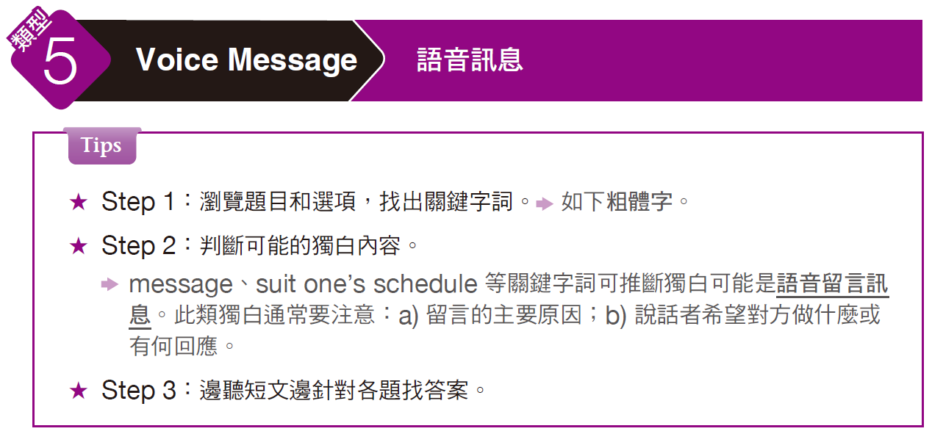
實戰篇 Unit 4

Slide 39
實戰篇 Unit 4
Example
B
D
B
1. What is the message mainly about?
(A) Annual budget
(B) Marketing strategy
(C) Online games
(D) Party plans
2. What kind of advertising does the speaker’s boss like?
(A) Newspaper ads
(B) Traditional advertising
(C) Inexpensive advertising
(D) Internet advertising
3. Which of the following would suit the speaker’s schedule?
(A) Monday at 3 p.m.
(B) Tuesday at 9 a.m.
(C) Tuesday at 2 p.m.
(D) Wednesday at 9 a.m.

Slide 40
實戰篇 Unit 4
錄音內容 & 解析
聽到介紹句 “ . . . voice-mail message” 確定此為電話語音留言。
Questions 1-3 refer to the following voice-mail message.
Hi, Tom. It’s Jennifer. Listen, I need to meet with you next week to discuss our advertising plans.
Q1
開頭用 Listen, . . . 乃喚起對方注意。本題為主旨題，獨白中提到要討論 advertising plans，選項之中僅有 (B) 的 Marketing strategy「行銷策略」與其意思相近。主旨題可聽完獨白後，最後作答並確認答案。

Slide 41
實戰篇 Unit 4
I need to know how much money you want to spend on advertising and what kind of ads you want to use. Remember, our director—and she’s the big boss—our director likes to see a lot of Internet advertising. She thinks online ads are the best way to go. But let me know what you think is best.
Can we meet early Monday morning or Tuesday morning? Those are the best times for me.
Q2
屬細節題，在此要仔細聽題目所問 boss 的意見，online ads = Internet advertising，故答案選 (D)。
Q3
亦屬細節題，問最適合的會面時間，選項中符合獨白中 Monday morning 或 Tuesday morning 時段的答案為 (B)。

Slide 42
實戰篇 Unit 4
中文翻譯
嗨，湯姆，我是珍妮佛。是這樣的，我下週得和你見面，討論我們的廣告計畫。我得知道你想要在廣告上花多少錢，以及你想要用什麼樣的廣告。別忘了，我們的主任，也就是我們的大老闆，她想要看到很多網路廣告。她認為網路廣告是最佳的廣告方式。但是請告訴我你認為最棒的方式是什麼。我們能否下星期一一早或是星期二早上見面？那些時間對我來說最方便。

Slide 43
實戰篇 Unit 4
Exercise
Listen to the audio track. Answer the three questions about what the speaker says in the talk.
C
D
C
1. What is Mark Peterson concerned about?
(A) Fire
(B) Flooding
(C) Theft
(D) Typhoons
2. Which of the following is Mark Peterson NOT interested in?
(A) An alarm
(B) An ID entry system
(C) Locks
(D) Fire extinguishers
3. What does Mark Peterson want the company he is calling to do?
(A) Take away their laptops
(B) Fix their computers
(C) Send over a consultant for a meeting
(D) Work with the fire department for fire safety

Slide 44
實戰篇 Unit 4
錄音內容
Questions 1-3 refer to the following voice-mail message.
Hi, John. My name is Mark Peterson and I am calling to ask about your company’s security services. My company has just opened a new office here in the city, and we need a consultant to help us with security. We are worried because there have been a lot of thefts in the area. A lot of offices have been broken into. I hear thieves are looking for laptop computers, smartphones and other electronics. So we want to install modern locks and an ID card entry system, along with security alarms and other measures. Please give me a call if you could. I’d be very interested in getting someone from your company to come over and meet with us. Again, my name is Mark Peterson. I can be reached at 55-217-0900. Thanks.
• consultant (n.) 顧問 • theft (n.) 偷竊；盜竊
• break into 闖入；闖空門 • measure (n.) 措施；手段

Slide 45
實戰篇 Unit 4
中文翻譯
嗨，約翰，我叫馬克‧彼得森，我打電話來是要詢問關於貴公司的保全服務。我們公司剛在城裡開了一間新辦公室，我們需要一名顧問來協助我們做保全。我們很擔心，因為本區發生了很多竊案，很多辦公室都被宵小闖入。我聽說竊賊都在找筆記型電腦、智慧型手機和其他電子產品。所以我們想要裝設現代化的鎖和識別卡進入系統，還有防盜警鈴及其他措施。如果可以的話，請撥電話給我。我很希望貴公司能有人過來我們這邊見個面。我重複一次，我叫馬克‧彼得森，我的電話是 55-217-0900，謝謝。

Slide 46
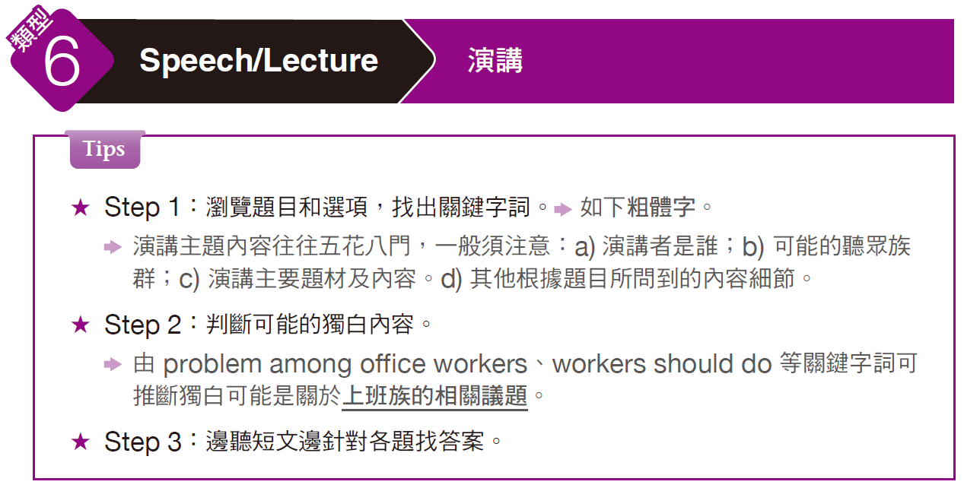
實戰篇 Unit 4

Slide 47
實戰篇 Unit 4
Example
B
C
C
1. What is the talk mainly about?
(A) Obesity problems
(B) Health condition of office workers
(C) Employee satisfaction
(D) Energy saving in the office
2. Which of the following is NOT mentioned as a problem among office workers?
(A) Back problems
(B) Pain in the forearms and hands
(C) Poor hearing
(D) Poor physical condition
3. What is the most important thing workers should do?
(A) Eat a good breakfast
(B) Exercise in the morning
(C) Get up from their desk each hour
(D) Take the stairs up to their office

Slide 48
實戰篇 Unit 4
錄音內容 & 解析
聽到介紹句 “ . . . Speech” 得知此為某種主題的演講。
Questions 1-3 refer to the following speech.
Hi, my name is Tony, and today we’re going to talk about how we office workers can stay in good condition. Most of us spend the better part of our day sitting at a desk and looking at a computer. This might seem restful, but it is not what the human body was built to do.
Q1
「主旨題」可最後作答。獨白主要是講上班族久坐導致的健康問題，故答案選 (B)。另外，選項 (A) Obesity problems 指「肥胖問題」，雖文中有提到overweight「超重」，但非全文主旨。

Slide 49
實戰篇 Unit 4
We wind up with back problems, neck problems, and of course carpal tunnel syndrome, which gives us pain in our hands and forearms. We might also wind up overweight and in poor physical condition.
So this is what we have to do: First, start your day with 20 minutes of stretching exercises. Next, take the stairs to your office, not the elevator. And this is most important: every hour, you have to get up from your desk, stretch and take a short walk. Little things like these can make a world of difference in how we feel.
Q2
題目含 not 字眼的「除外題」，須注意聽獨白中沒有提到哪一個選項，故答案選 (C) Poor hearing「聽力不佳」。
Q3
問「上班族該做哪一件最重要的事？」，與獨白中 . . . every hour, you have to get up from your desk . . .相符的選項為 (C)。

Slide 50
實戰篇 Unit 4
中文翻譯
大家好，我是湯尼，今天我們要來談辦公室的上班族要如何保持良好的健康狀況。我們多數人幾乎一整天都坐在桌子面前，盯著電腦看。乍看之下這樣好像有在休息，但這麼做並不適合人體的構造。結果我們的背出問題、頸子出問題，當然還有腕隧道症候群，讓我們的手和前臂感到疼痛。我們還可能會超重，並且體能狀況欠佳。所以我們必須這麼做：首先，每天一早做二十分鐘的伸展運動。其次，走樓梯到辦公室，不要搭電梯。最重要的一點是：每小時你都應該要從座位上起身、伸展，並且散一點步。像這樣的小事可以讓我們的身體感到極大的不同。

Slide 51
實戰篇 Unit 4
Exercise
Listen to the audio track. Answer the three questions about what the speaker says in the talk.
B
B
D
1. What is the main topic of the talk?
(A) How the real estate market crashed
(B) Why it’s a good time to buy houses
(C) Whether interest rates will change
(D) Who can benefit from fixed-rate loans
2. According to the speaker, what is true about current interest rates?
(A) Most people think they will go down.
(B) Most people know they are very low.
(C) It is easy to get a mortgage at over five percent.
(D) The interest rates will stay low for a long time.
3. What is the worry about investing in real estate now?
(A) Home prices may go up soon.
(B) Interest rates may drop further.
(C) Many people are buying homes now.
(D) Home values may go lower.

Slide 52
實戰篇 Unit 4
錄音內容
Questions 1-3 refer to the following speech.
Hi, my name is Lisa Bennett and today we’re going to look at why now is the time to invest in real estate. To begin with, it is no secret that interest rates are at historic lows. It’s easy today to lock in interest rates under five percent on fixed-rate home loans. But it’s important to remember those interest rates won’t stay low forever. They’ll go up soon. The worry of course is whether the real estate market has bottomed out —that is, whether housing values will continue to fall. But if we haven’t hit bottom, we have certainly neared it. We already see many positive real estate reports showing new-home construction is up and home sales are up for some months. Clearly, many investors are already snapping up cheap and foreclosed homes. They know that even if the values of those homes go down, they will come back, and the current low interest rates make investing now the right thing to do.
• interest rate 利率 • bottom out 降至最低點；（股票等）止跌回升
• snap up 抓取 • foreclosed home 法拍屋

Slide 53
實戰篇 Unit 4
中文翻譯
大家好，我叫麗莎‧班尼特，今天我們要來看為何現在是投資房地產的最佳時機。首先，大家都知道利率正處於歷史低點。現在要鎖定低於百分之五的固定利率房貸是件容易的事。但是必須要記住，利率不可能永遠處於低檔，而是很快就會走高。當然，大家擔心房地產市場是否已經觸底了，也就是房屋的價值是否會繼續下滑。如果現在還沒觸底，肯定離觸底也不遠了。我們已經看到許多正面的房地產報告，顯示新屋建造率已經上升，而房屋成交量則已經上揚幾個月了。很顯然的，很多投資人已經在搶進低價的法拍屋了。他們知道就算那些房子的價值下滑，其價值終究會回升的，而目前的低利率則讓投資成為正確之舉。

Slide 54
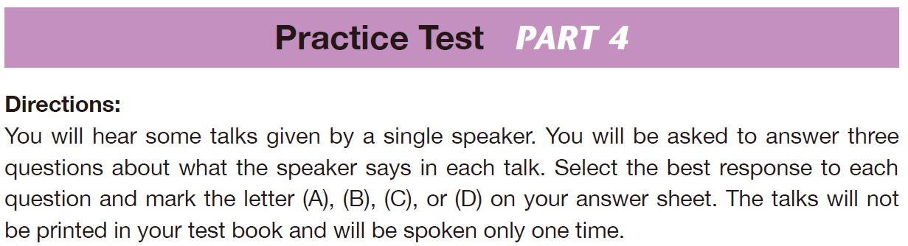
實戰篇 Unit 4

Slide 55
實戰篇 Unit 4
A
C
C
1. According to the speaker, what can you do with your cars?
(A) Make them tax deductible
(B) Refund the taxes on them
(C) Pay them off
(D) Pay more taxes on them
2. What does the company claim it will do regarding your taxes?
(A) Cover your travel expenses
(B) Send your children to college for free
(C) Save you 50 percent
(D) Pay for your medical expenses
3. What tax deduction is NOT mentioned in the advertisement?
(A) University tuition
(B) Automobiles
(C) Housing
(D) Medical costs

Slide 56
實戰篇 Unit 4
錄音內容
Questions 1-3 refer to the following radio advertisement.
That’s right. Your quarterly taxes are almost due again. Do you feel like you’re paying too much in taxes? We offer tax advantages for your home or business. Write off your travel and vacation expenses. Turn your home office into a tax deduction. Make all your cars tax deductible. Write off your medical expenses. Pay your children $4,700 a year and you’ll be able to send them to college tax free. Yes, you heard me right. I can help you cut your taxes in half! Call me, George McSavings, at 1-888-545-6787.
• quarterly (adj.) 季度的
• write off（從帳目上）勾銷
• deduction (n.) 扣除；減除
• deductible (adj.) 可扣除的

Slide 57
實戰篇 Unit 4
中文翻譯
沒錯，您的季稅又快要到期了。您是否覺得您繳太多稅了呢？我們提供您的家庭或企業稅賦優惠。勾銷您的旅行和度假開支，將您的家庭辦公室變成扣稅項目。讓您的每輛車都能扣稅。勾銷您的醫療開支。每年付給您的孩子四千七百美元，您還能送他們讀大學，而且稅賦全免。是的，您沒聽錯，我可以幫您減少一半的稅賦支出！打電話給我，請撥 1-888-545-6787，找喬治‧麥克塞溫斯。

Slide 58
實戰篇 Unit 4
C
D
C
4. What is the speaker trying to interest the investors in?
(A) New ways to use video for training
(B) How video can improve sales efforts
(C) His company and its video software
(D) Spending more on video management
5. What is wrong with many companies’ video software?
(A) It is outdated and slow.
(B) It is surprisingly difficult to use.
(C) The quality is like YouTube’s.
(D) It is more expensive than it should be.
6. What will happen next?
(A) The speaker will upload a video to YouTube.
(B) The audience will watch a short video.
(C) The speaker will project something on a screen.
(D) They will discuss the high cost of TVS.

Slide 59
實戰篇 Unit 4
錄音內容
Questions 4-6 refer to the following talk.
Hi, my name is James Kyle, and today I’m going to tell you about a company that is poised to take off. Our company, TVS, or Total Video Solutions, has put together a video package that is truly unique. As you know, video is taking off today. People are using video for communication, companies are using video for training and other purposes, and more and more video is becoming an integral part of sales. Several software makers have put together software suites that allow companies to make and manage video, but most of these are surprisingly expensive—up to sixty thousand dollars a license. But in a day and age when a teenager can take a video with a cell phone and instantly upload it onto YouTube, we believe it shouldn’t be so pricey. And with that in mind we built our Total Video Maker and Total Video Manager suites. Now, let’s have a look at a short PowerPoint presentation I have made here.
• (be) poised to V. 做好準備做…… • integral (adj.) 不可缺的；重要的

Slide 60
中文翻譯
您好，我叫詹姆士‧凱爾，今天我要向各位介紹一家準備好要大展宏圖的公司。我們公司，簡稱 TVS，全名叫做整體影像解決方案，已經製作出了一個真正獨特的影片方案。誠如各位所知，影像在這個時代正大大地受到歡迎。人們利用影像來溝通、公司利用影像來作為訓練工具或其他用途，有越來越多影像成為銷售中不可或缺的一部分。有好幾家軟體製造商製作出所謂的套裝軟體，讓公司得以拍攝並管理影像，但是這些軟體大部分都貴得嚇人，一套授權最高要價六萬美元。但是在現在這個時代，年輕人可以用手機拍攝影片，並立刻上傳到 YouTube ，所以我們相信價格不應如此昂貴。在考量到這一點之後，我們製作出了整體影像製造家和整體影像管理套裝軟體。我們現在就來看看我所製作簡短的投影片簡報。

Slide 61
實戰篇 Unit 4
A
C
C
7. Who is most likely the audience of this speech?
(A)New employees
(B) High school students
(C) College graduates
(D) Business owners
8. What is TRUE according to the speech?
(A) The listeners will share their life stories later.
(B) Everyone can go swimming at the party.
(C) There are several buildings at this location.
(D) The teachers will be too busy to interact with everyone.
9. What does the speaker mean when he says “send you off”?
(A) He will put something in the mail.
(B) He wants everyone to go off on their own.
(C) He is saying they can start the tour.
(D) He’s telling everyone they can go home.

Slide 62
實戰篇 Unit 4
錄音內容
Questions 7-9 refer to the following speech.
Good morning! I would like to welcome all of you to today’s orientation. We want you all to get the big picture here, so we aren’t even going to show you your work stations until tomorrow. Consider yourselves students for the day! We’ll begin by touring through every single building and talking about the purpose of each one. We’ll also be talking to many existing members of staff and hearing their stories. We even have some group events lined up just for you, and we hope these help everyone create strong bonds that will last throughout your careers. After that you’ll have about an hour of personal time to do whatever you feel—perhaps, say . . . wander around the grounds or . . . call your parents to tell them how great things are here! And finally, tonight is the night of our monthly company party, so you’ll also have a chance to mingle with the people who were too busy to meet you in the daytime. That’s all you need to know for now, so let’s //send you off//!
• orientation (n.) 培訓
• tour (v.) 參觀
• bond (n.) 聯繫；連結
• mingle with （與人）交往、談話

Slide 63
實戰篇 Unit 4
中文翻譯
早安！我想要歡迎各位來參加今天的培訓。我們想要你們所有人瞭解公司整體的狀況，所以我們會到明天才讓各位看看你們的工作站。今天就把自己當作學生吧！我們會先走遍每棟大樓，談談每棟大樓的用途。我們還會和許多現職員工談談，聽聽他們的故事。接下來我們甚至還有一些專為你們設計的團體活動，我們希望這些活動會幫助大家建立起能持續整個職業生涯的緊密連結。之後你們會有大約一小時的個人時間，可以做你們想做的事—或許比如說……到四周走走或是……打電話給父母告訴他們這裡有多棒！最後，今晚是我們公司每月的派對，所以你們也有機會和在白天太忙而無法和你們見上一面的人聊聊。那就是各位目前需要知道的事情，那麼就讓我們帶各位出發吧！

Slide 64
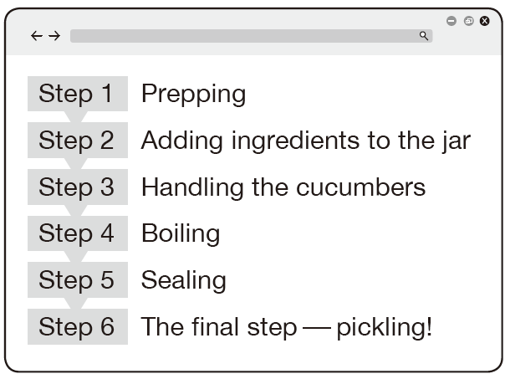
實戰篇 Unit 4
C
A
A
10. Where would someone most likely listen to these instructions?
(A) In a cooking class
(B) In their garden
(C) At home
(D) On a farm
11. What does the speaker mean when she says, “Think again”?
(A) This step is very involved.
(B) This step doesn’t involve vegetables at all.
(C) The instructions are too difficult to follow without the list.
(D) You don’t need to wash the vegetables.
12. Look at the graphic and consider
the conversation. Which step is
the woman describing?
(A) Step 1
(B) Step 2
(C) Step 5
(D) Step 6

Slide 65
實戰篇 Unit 4
錄音內容
Questions 10-12 refer to the following excerpt from a presentation and list.
Hey guys! Welcome to this web episode of “The Great Indoors,” which is part of a six-part series breaking down all the steps to making your own pickles. Keep your step-by-step instructional sheet handy to refer to along the way. If you don’t have it yet, click the link below to download it or print it out. OK, now in this step . . . you might think it’s easy. //Think again.// There’s more to it than simply washing your vegetables. The quality of your jar has a major impact on your final product. So drop everything else. Grab your jar and make sure it’s clean as a whistle. To do that, first you’re gonna want to use some simple dishwashing soap and water. After that, you need to soak your jar in white vinegar or baking soda for a couple of hours. When you get back to your jar . . . maybe three hours later . . . scrub it with a good scrub brush and rinse it thoroughly. If you have time, I also highly recommend drying it in the sunshine for one or two days. This gets rid of any contaminants and foul odors, and you’ll know that your jar is going to give you the best pickle flavor at the end. Finally, with your jar fully sanitized, you can go ahead and wash those vegetables.
• episode (n.) （節目的）一集
• break down 分析
• pickle (n.) 醃黃瓜；醃菜 ＆ (v.) （用鹽滷或醋）醃製
• clean as a whistle 清潔溜溜；一塵不染
• scrub (v.) 用力擦洗
• rinse (v.) 沖洗
• contaminant (n.) 污染物
• foul odor 臭味
• sanitize (v.) 給⋯⋯消毒

Slide 66
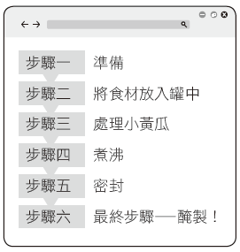
實戰篇 Unit 4
中文翻譯
嘿各位！歡迎來到這一集網路節目「室內奇兵」，本系列節目一共六集，完整剖析自製醃黃瓜的所有步驟。手邊請準備好全程用來參考的步驟說明表。如果你還沒有這張表， 請點擊下面的連結下載它或是將它印出來。好的，在此步驟中……你也許認為這很容易。但請三思。這不只是像洗菜這麼簡單。你的罐子品質對於最後成品有著重大影響。所以請放下手邊其他的事。拿起罐子且一定要把它洗乾淨。要做到這一點，首先要用一些簡單的洗碗精和水來洗。之後你需要把罐子浸在白醋或是小蘇打裡幾個小時。當你回來處理罐子時……也許是三小時後……拿個好刷子徹底刷洗它。你若有時間，我也強烈推薦將罐子放在陽光底下曬個一兩天。這樣會去除掉所有的污染物和臭味，而你將知道最後你的罐子會帶給你最美味的醃黃瓜。最後，你的罐子經過充分消毒後，你就可以開始洗菜了。

Slide 67
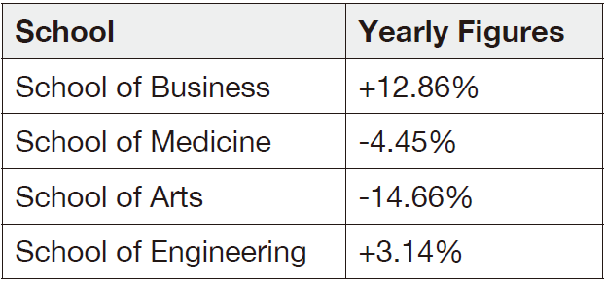
實戰篇 Unit 4
B
D
B
13. What is the meeting going to be about?
(A) Sales numbers
(B) Enrollment numbers
(C) An employee being fired
(D) Congratulations for a job well done
14. Where does the speaker most likely work?
(A) An engineering firm
(B) A financial firm
(C) A recruiting firm
(D) A university
15. Look at the graphic and consider
the talk. What was the yearly
figure for the school of
engineering?
(A) +3.14%
(B) -3.14%
(C) +6.28%
(D) +12.86%.

Slide 68
實戰篇 Unit 4
錄音內容
Questions 13-15 refer to the following excerpt from a speech and statistics.
Good afternoon, everyone. Thank you for your punctuality. Our meeting shouldn’t take more than one hour, so, if you don’t mind, let’s go ahead and get started. We are here today to talk about our recruiting numbers . . . ahem . . . They are very low, and it is cause for concern. Over the past five years, we have seen a downward trend in applications to the University of South Kentucky. The School of Business is the only school to have enjoyed a growth in applications this year. I see that the chart indicates that the engineering school has seen an increase, too; however, this is a typo. The numerical figure is correct—it should simply be a decrease rather than an increase.
• downward (adj.) 下降的
• typo (n.) 打字（或排印）錯誤
• numerical (adj.) 數字的
• figure (n.) 數字

Slide 69
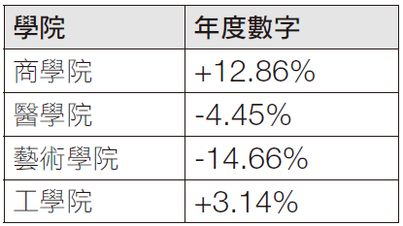
實戰篇 Unit 4
中文翻譯
各位午安。感謝各位準時到場。我們的會議應該不會花超過一個小時，那麼，如果大家不介意的話，就讓我們開始吧。我們今天在此是要談談我們的招生人數……呃哼……人數很少，而這是我們擔憂的原因。過去五年來，我們已看到南肯塔基大學的申請人數呈現下滑趨勢。商學院是今年唯一申請人數有成長的學院。我瞭解圖表顯示工學院也有成長；然而，這是打字錯誤。數字是正確的—只是應該是減少而非增加。

Slide 70
實戰篇 Unit 4
「簡短獨白」
各類題材攻略
-The End-

